Slide 1

Serial Communication Using OnChip UART
The acronym UART stands for “Universal Asynchronous Receiver Transmitter” – it is name given to a Peripheral which supports Serial Communication using a certain protocol.
This name was suggested by a committee called as Electronics Industry Association(EIA) & sometimes also called as Electronics
Industry Alliance(EIA).
UART peripheral can be offchip peripheral also in the form of an IC example Intel’s 8250,8251 &,16550 ,etc. Off Chip UART chips/ICs are peferrably used with a microprocessor since these don’t come which On Chip UART peripheral.

Slide 2
Can also be used with microcontrollers in case in the need for additional Off Chip UART peripheral apart from On Chip UART peripheral for any typical application of Embedded System’s Requirement.
OR
else a microcontroller with more than one On Chip UART peripheral can be selected for a typical application of Embedded System’s Requirement.
OR
A Soft UART (i.e Bit Banging approach of UART Peripheral’s Protocol) Could also be possibly Implemented through the use of
General Purpose I/O pins and software statement instead of dedicated hardware peripheral/logic for same typical requirement.

Slide 3
In the Intel’s 8051 architecture & compatible versions of microcontroller(s) there is ONLY provision for ONE ON CHIP UART Peripheral. But in Extended Versions/Variant of 8051 family of controllers there may be provision for 2 or more ON CHIP UARTs.
Now considering ONLY Intel’s 8051 architecture & compatible versions of microcontroller the SFRs associated with ON CHIP UART peripheral are name
SCON,SBUF,TMOD,TCON,TH1,TL1,PCON for Without Interrupt Based for UART Communication.
Addition IE & IP for Interrupt Based UART Communication

Slide 4
Serial Data Input/Output
SBUF is physically two registers.
One is write only and is used to hold data to be transmitted out of the 8051 via TXD.
The other is read only and holds received data from external sources via RXD.
Both mutually exclusive registers use address 99h.

Slide 5
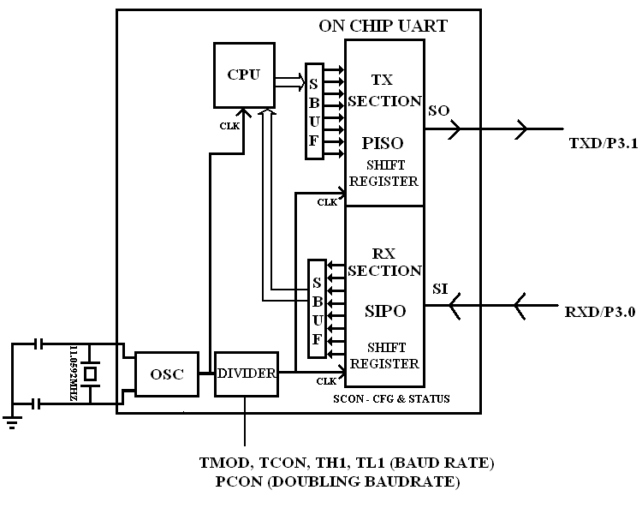
Generic PIC of On-Chip UART Periperal

Slide 6
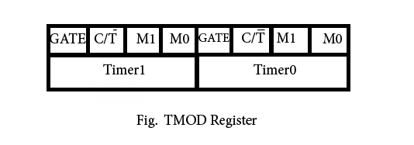
Discussions OF SFRs Associated with On Chip UART
SCON ( Serial Port Control Register) –
Is Used for Configuring the Mode(s) of Operation of the UART Peripheral ,as Synchronous Serial Communication Mode Or Asychronous Serial Communication Modes.
The On Chip UART supports 1 Mode of Sychronous Serial Communication & 3 Modes of Asychronous Serial Communication – namely mode0(synchronous),mode1,mode2,mode3(asychronous).
Additionally SCON register can also be used for monitoring the status of Serial Data transmision/Reception Completion/Or Not using status flags.

Slide 7

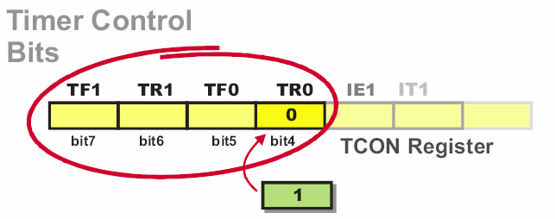
SFRs Illustration Cont’d

Slide 8


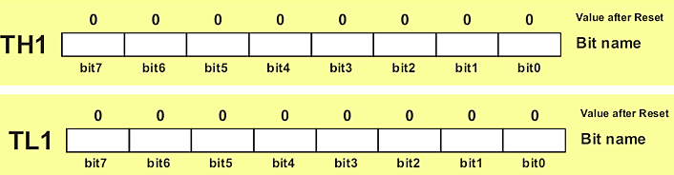
SFRs Illustration Cont’d

Slide 9

TO set SMOD bit,
PCON = 0X80; / PCON = 1<<7;

Slide 10
UART’s MODES of Operations
MODE 0- Shift Register mode (Synchronous,FBR)
MODE 1-Standard UART mode (Asynchronous,VBR)
MODE 2- Multiprocessor mode (Asychronous,FBR)
MODE 3-Similar to mode2 (Asychronous,VBR)

Slide 11
Serial port control (SCON)
SM0 SM1 Mode Description
0 0 0 8-bit UART;baud =f/12
0 1 1 10-bit UART;baud =variable
1 0 2 11-bit UART; baud =f/32or f/64
1 1 3 11-bit UART;baud =variable

Slide 12
UART’s Mode 0
Serial data enters and exits through RXD/P3.0
TXD/P3.1 outputs the synchronous/shift clock
8 bits are transmitted / received (LSB first)
The baud rate is fixed at 1/12 the oscillator frequency

Slide 13
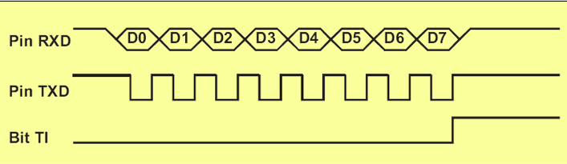
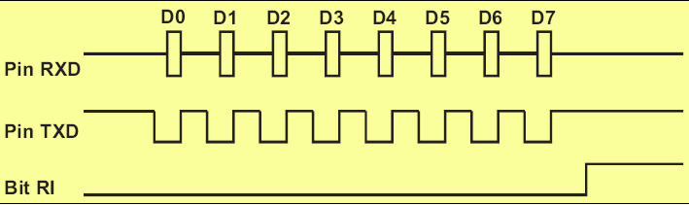
UART MODE 0

Slide 14
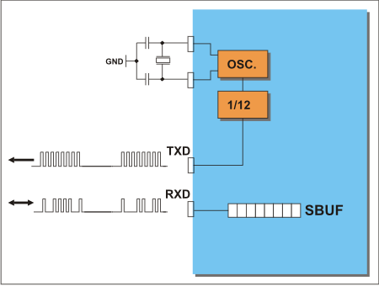

Slide 15
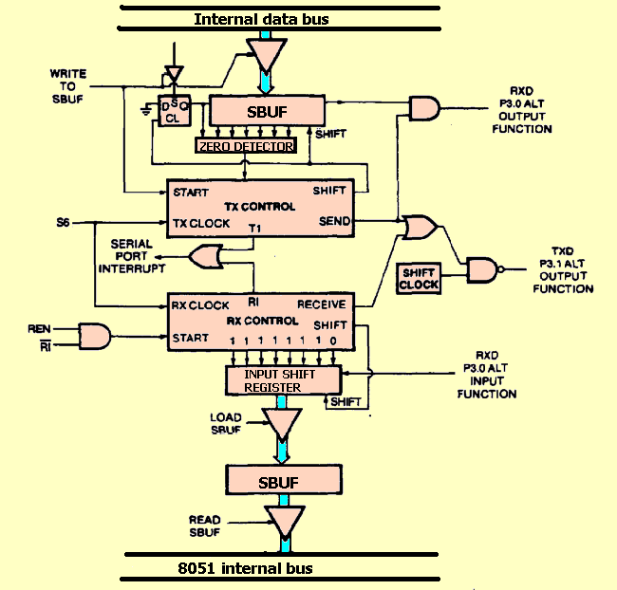
Serial Mode 0-Functional diagram

Slide 16
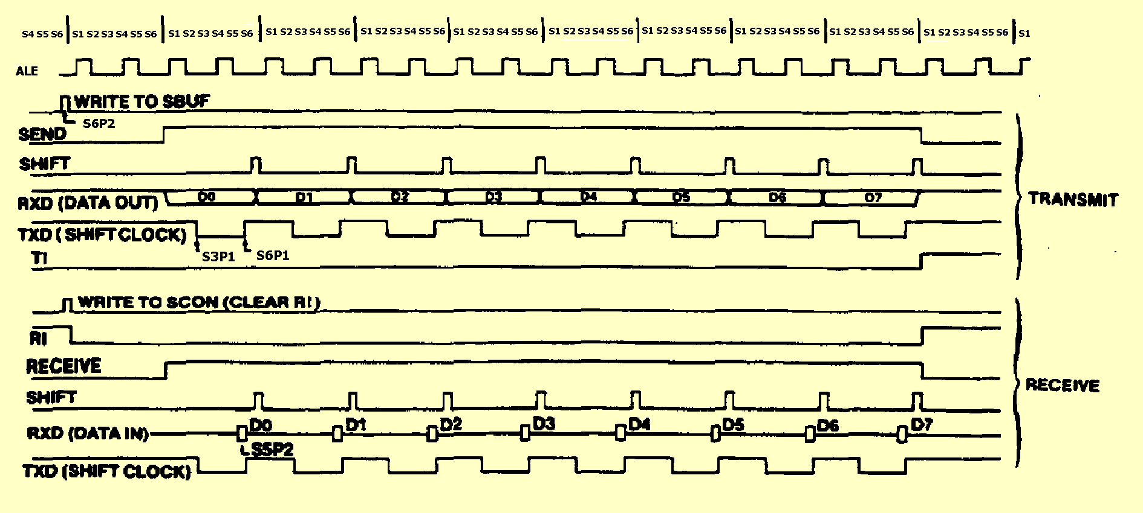
Serial Mode 0-Timing

Slide 17
UART’s Mode 1
10 bits are transmitted through TXD or received through RXD
  a start bit (0) , 8 data bits (LSB first) and a stop bit (1)
On receive, the stop bit goes into RB8 in SCON
Baud rate is variable
BAUD=((2^SMODxCF)/(12x32x(256-TH1)))
If SMOD=0/1 in PCON it IMPLIES
=1or2 x (CF/(12x32x(256-TH1)))
TH1 = 256 - ((CF / 384) / BAUD)

Slide 18
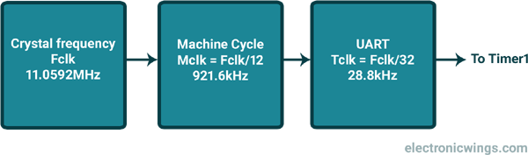

Slide 19
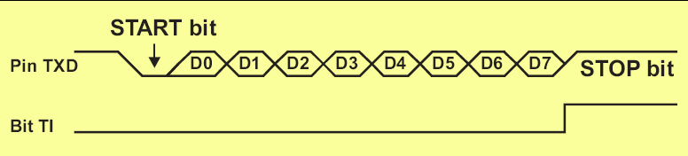
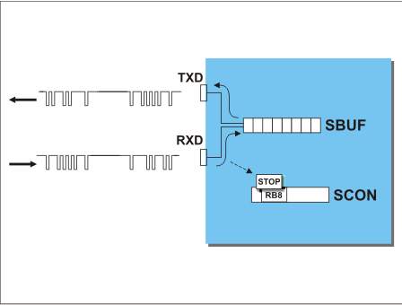
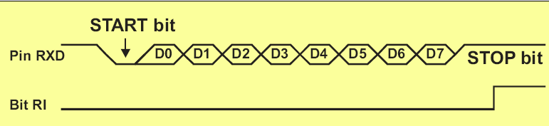

Slide 20
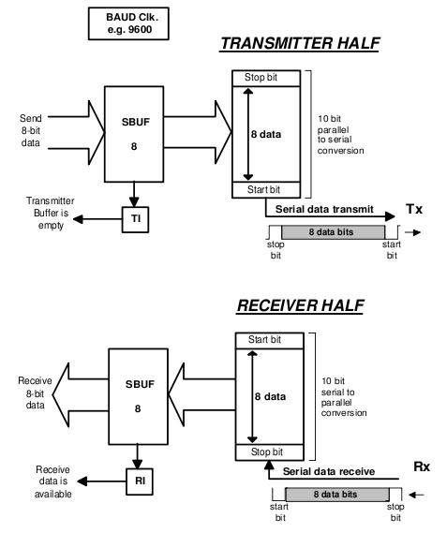

Slide 21
Serial Mode 2
11 bits are transmitted through TXD or received through RXD
a start bit (0), 8 data bits (LSB first) , a programmable 9th data bit and a stop bit (1)
On transmit, the 9th data bit (TB8 in SCON ) can be assigned 0 or 1
On receive, the 9th data bit goes into RB8 in SCON , stop bit is ignored
Programmable baud rate 1/32 or 1/64 the oscillator frequency

Slide 22
Serial Mode 3
11 bits are transmitted through TXD or received through RXD
a start bit (0), 8 data bits (LSB first) , a programmable 9th data bit and a stop bit(1)
On transmit, the 9th data bit (TB8 in SCON ) can be assigned 0 or 1
On receive, the 9th data bit goes into RB8 in SCON , stop bit is ignored
Same as mode 2 with the baud rate variable

Slide 23
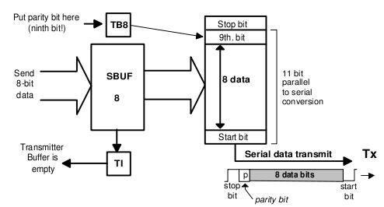
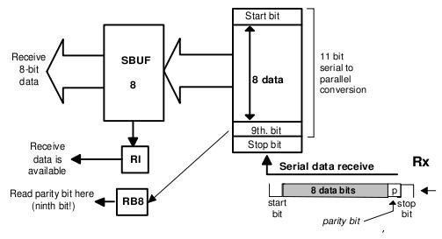

Slide 24
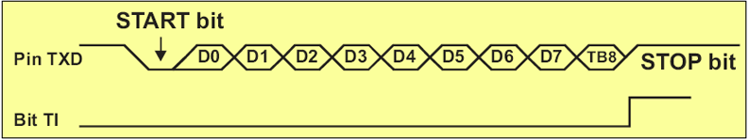
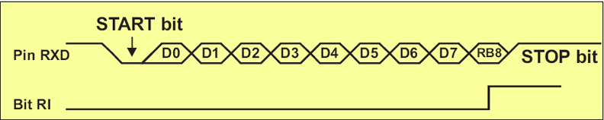
UART MODES(2&3)

Slide 25
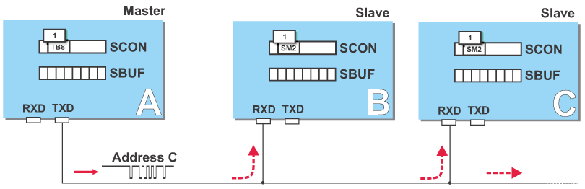
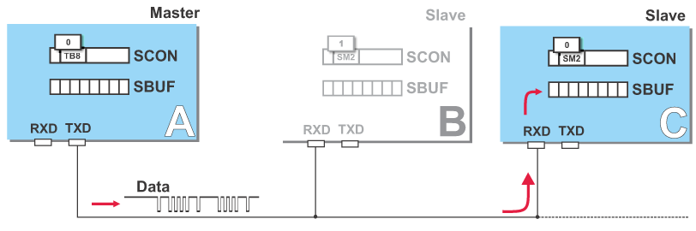

Slide 26
Baud Rate
Note:
With SM2=0 allows the reception of multiprocessor characters transmitted in modes 2 & 3.
With SM2=1, prevents reception of those characters that have bit 10 equal to 0 .
OR
If bit 10(TB8)=1,then reception always takes place;SM2 is ignored. If bit 10(TB8)=0,then only those receivers with SM2=0 are interrupted.

Slide 27
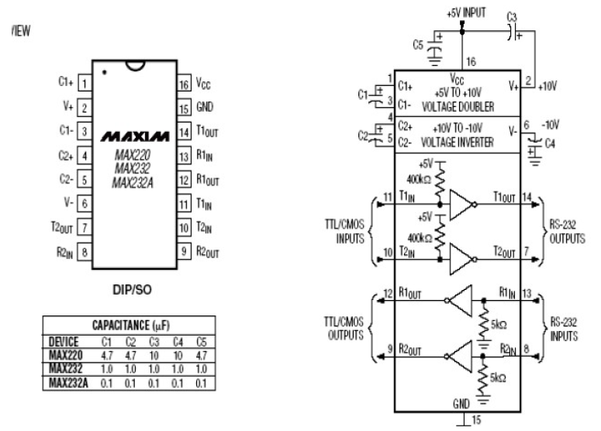

Slide 28
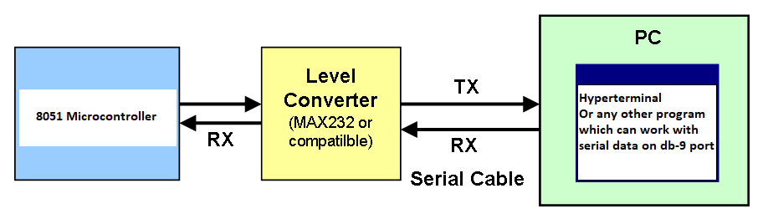

Slide 29
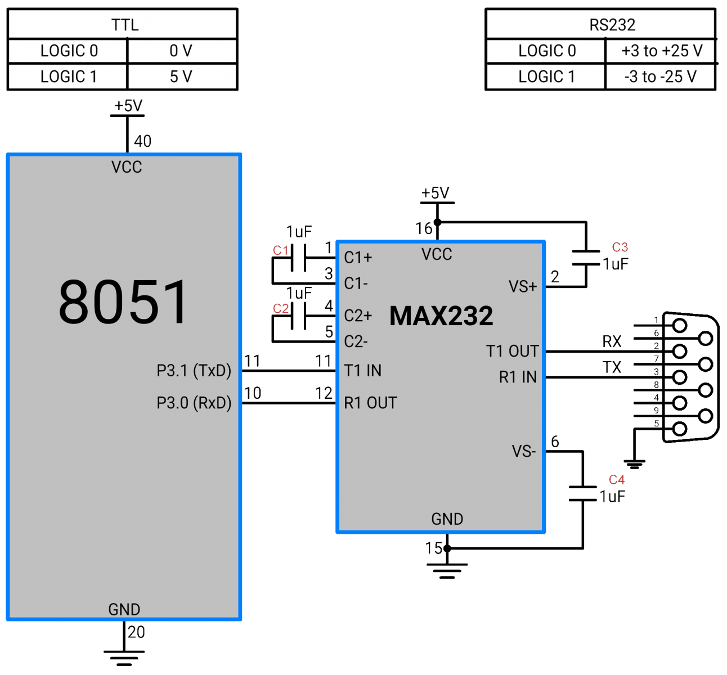

Slide 30
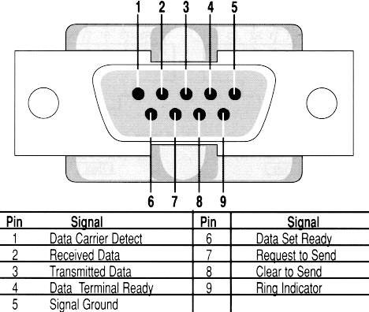

Slide 31
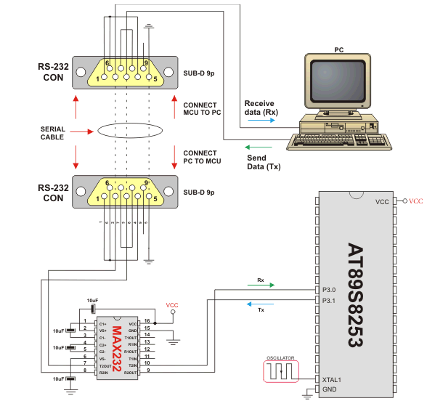

Slide 32
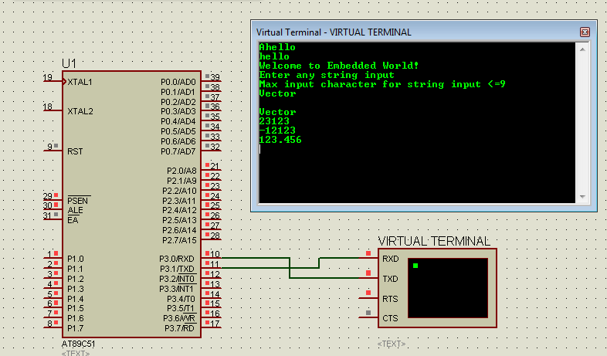

Slide 33
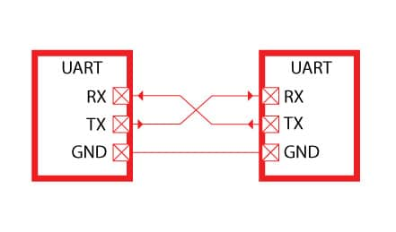
2 8051’s Having OnChip UART Can be Connected as given below:

Slide 34
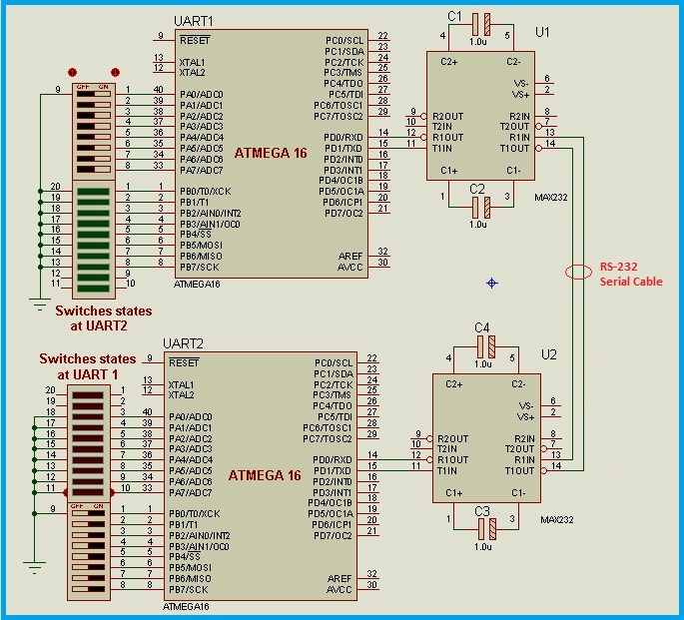

Slide 36
Idle Mode
Clock is gated of to the CPU
Clock is gated to Timer, Interrupts and serial port
CPU, SP, Acc, PC and all registers are preserved
Terminated either through hardware reset or interrupts

Slide 37
Power Down
Oscillator is frozen
On-chip Ram and SFRs are preserved
Terminated through a hardware reset
Vcc can be held as low as 2V

